Slide 1


SENTIMENTAL ANALYSIS
(CUSTOMER REVIEWS)
P-88 GROUP-7
Vishwas Suryawanshi
Mariah S Valiaveedan
Shweta Manche
Kumar
Yuvakiran
Dheebika T
Mentor- Varun

Slide 2

BUSINESS PROBLEM
Product Chosen – SJCAM SJ6 Legend Action Camera
After doing the Sentimental Analysis of the Customer reviews from Amazon Website about SJCAM SJ6 Legend Action Camera can the conclusions which are being mentioned below can be authorized :
Is the service incredible with its all good design abilities
Is the LCD panel assists in better control to all camera settings
Can access of all recording modes for underwater shooting be done
Is their low audio quality
Is the costing of the product impressive
Concluding all these features and doing the sentimental analysis of the customer reviews can this particular product SJCAM SJ6 Legend Action Camera can be a good replacement of GoPro Action Camera which is the best in this particular segment.

Slide 3
PROJECT ARCHITECTURE
DD
BUSINESS OBJECTIVE
DATA COLLECTION
EXPLORATORY DATA ANALYSIS
DATA PREPROCESSING
MODEL SELECTION
MODEL EVALUATION
MODEL DEPLOYMENT

Slide 4
BUSINESS OBJECTIVE
We need to understand the liking or disliking of that product (SJCAM SJ6 Legend Action Camera) to help the organization to make some decisions about the production and supply of the same in the market. So here consider extracting reviews from ecommerce websites and analyze them to satisfy the objective.

Slide 5
Data Collection
E-commerce Website : Amazon E-commerce Website
Product Chosen : SJCAM SJ6 Legend Action Camera
Web-scrapping done through following packages :
1. Requests Package
2. Beautiful Soup Package
3. Pandas Package
Data Collection :
5 Columns (viz. Product, Title, Rating, Date, Body)
148 Rows

Slide 6
Exploratory Data Analysis (EDA)

Slide 7
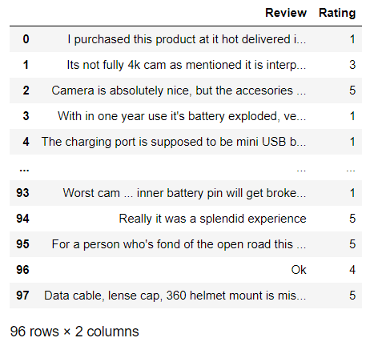
DATASET DETAILS
ROWS- 96
COLUMNS- 2
2 NULL VALUES
NO MISSING VALUES
NO DUPLICATE VALUES
NO OUTLIER
COLUMNS ‘REVIEW' AND ‘RATING' HAVE A VERY GOOD CORRELATION.

Slide 8
DATA PRE-PROCESSING

Slide 9
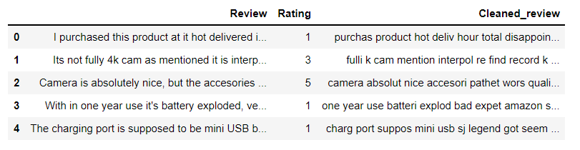
CLEANING THE DATASET
NORMALIZING THE REVIEW
REMOVING TERMS WITH SMALL / HIGH FREQUENCY IN THE GIVEN CORPUS
REMOVING THE SO-CALLED STOP-WORDS
REDUCING WORDS TO THEIR ROOT FORM THROUGH STEMMING OR LEMMATIZATION

Slide 10
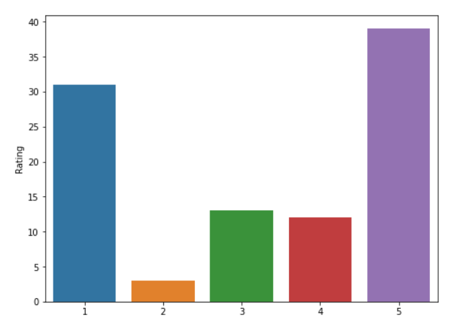
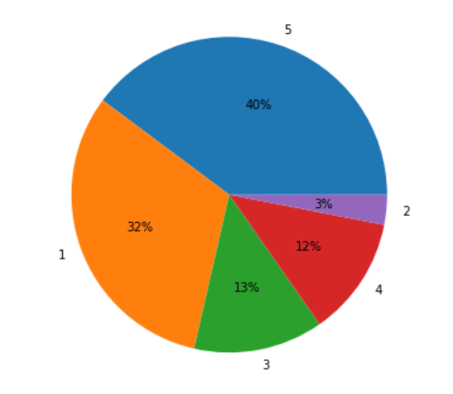
SORTING THE RATING
GROUPING THE RATING GIVEN ACCORDING TO THE CUSTOMER FOR THE FURTHER ANALYSIS

Slide 11
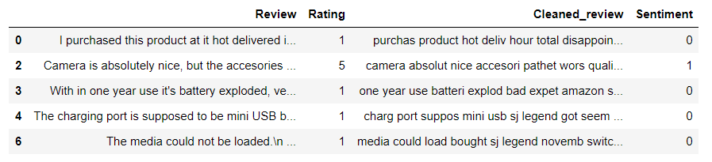
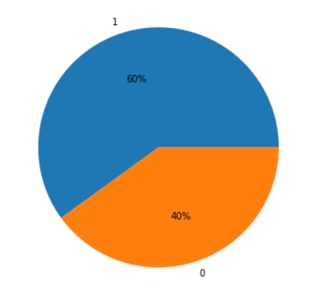
CALCULATING SENTIMENT VALUE
REMOVING DATA WITH RATING 3
CONSIDERING
RATING 1 & 2 => NEGATIVE REVIEW
RATING 4 & 5 => POSITIVE REVIEW
COMPUTING
SENTIMENT VALUE 0 FOR NEGATIVE REVIEW WHICH IS 40%
SENTIMENT VALUE 1 FOR POSITIVE REVIEW WHICH IS 60%

Slide 12
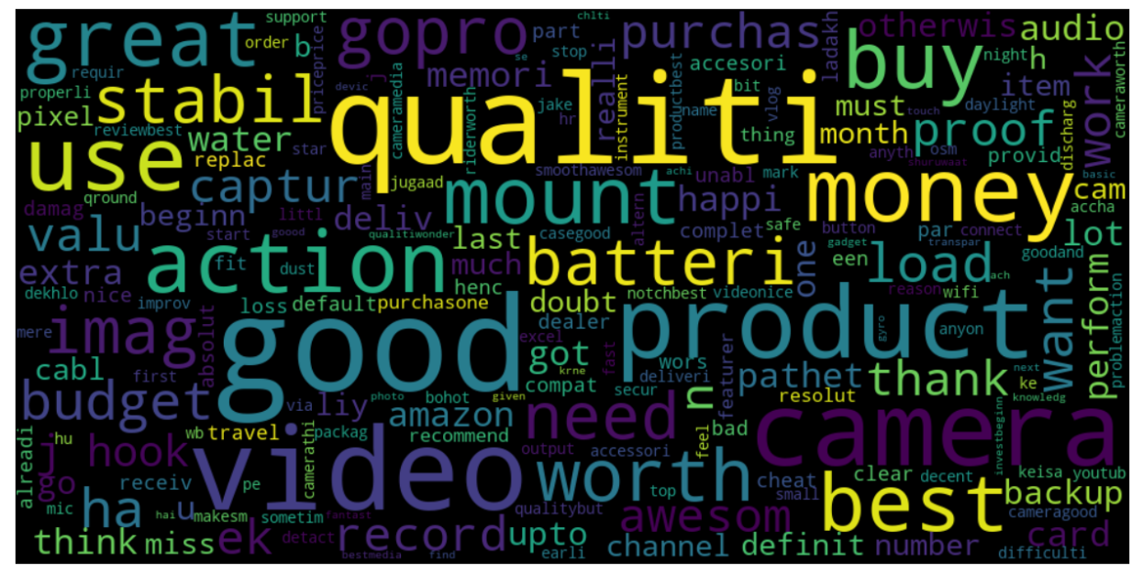
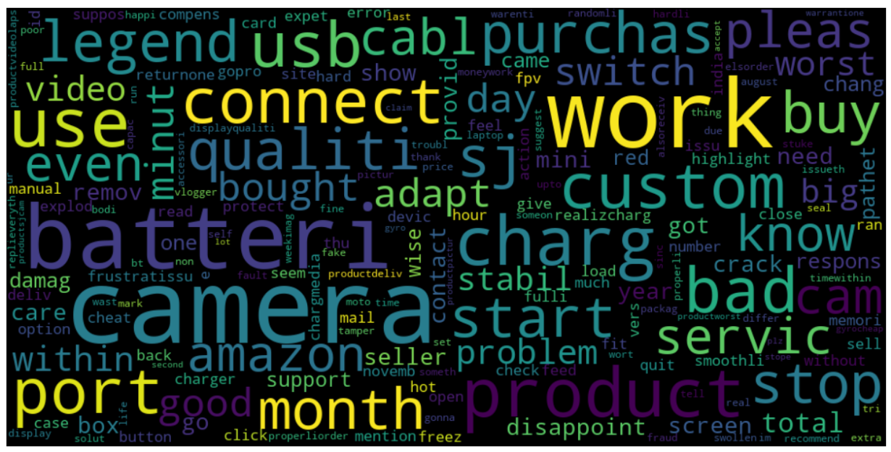
PLOTTING WORD-CLOUD
POSITIVE REVIEW WORDCLOUD :
NEGATIVE REVIEW WORDCLOUD :

Slide 13
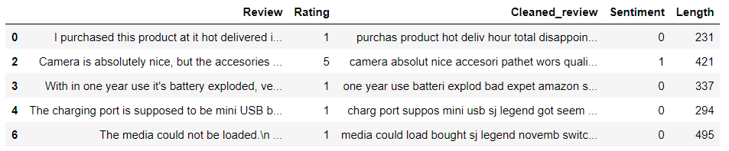
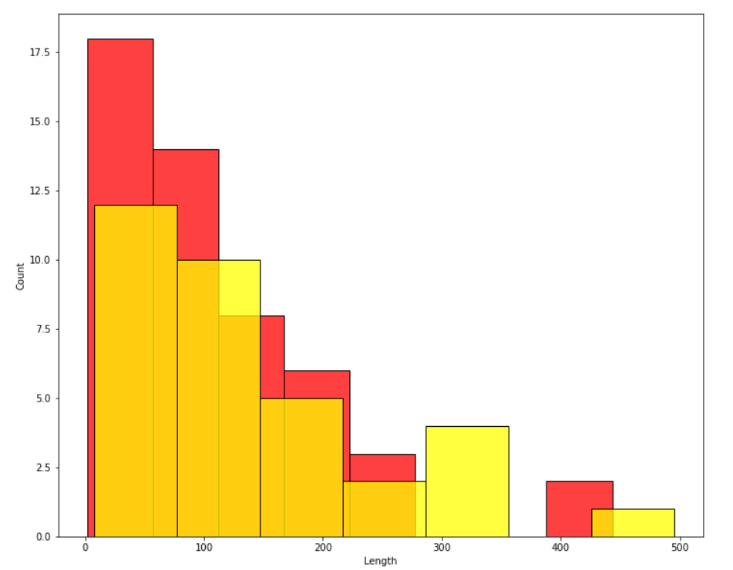
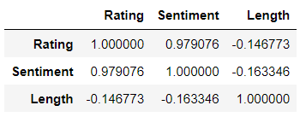
Calculating length of review
CORRELATION MATIX

Slide 14
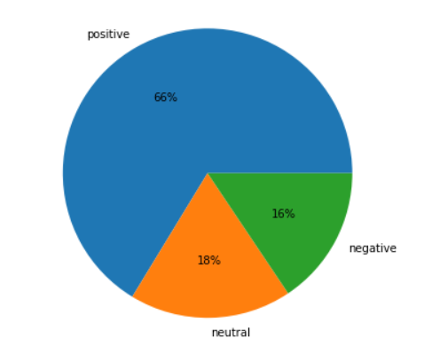
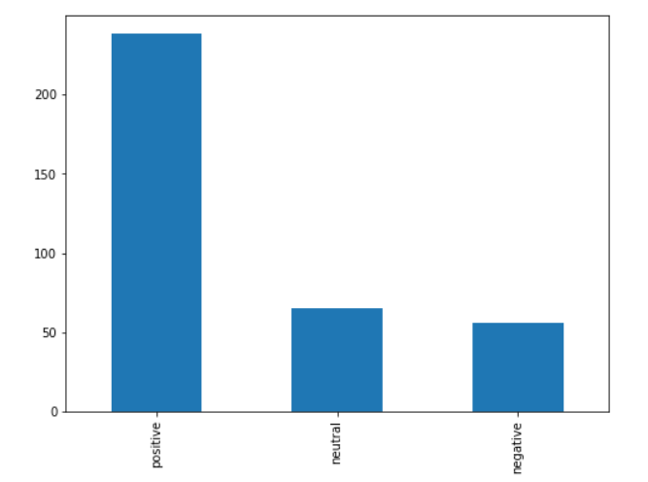
Vader Method for Sentiment Analysis
Positive Sentiments : 238
Neutral Sentiments : 65
Negative Sentiments : 56

Slide 15
MODEL EVALUATION

Slide 16

Splitting and balancing dataset
Splitting of the Dataset is done with the help of Sklearn Package
Count Vectorizer Package is used for conversion of Textual data into Binary dataset.
In this example we have used SMOTE-Tomek which is a method of Imblearn. SMOTE-Tomek is a hybrid method.
SMOTE-Tomek uses an under sampling method (Tomek) in with an over sampling method (SMOTE).

Slide 17
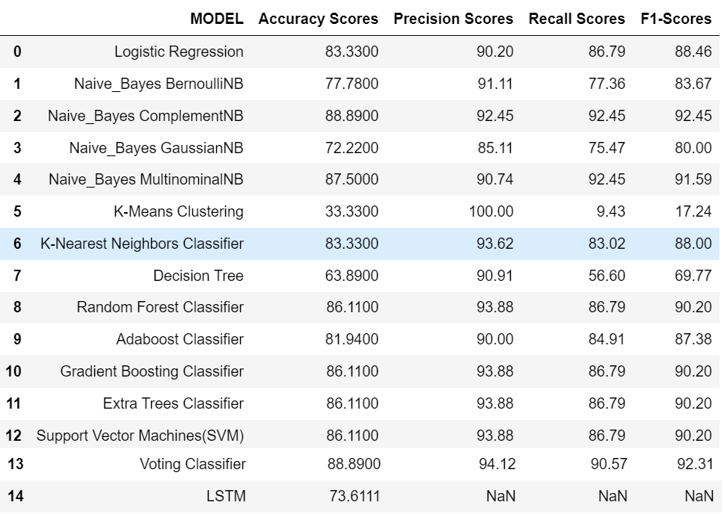
Comparison of models

Slide 18


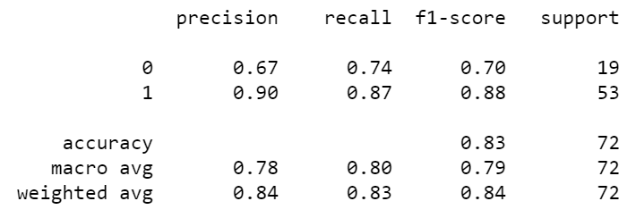
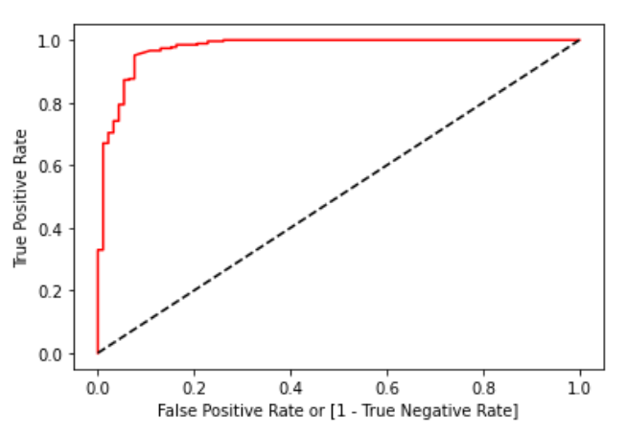
Final model
Logistic Regression is the final model we have selected
Confusion Matrix
Score
Classification
Report
ROC Curve

Slide 19
MODEL Deployment

Slide 20
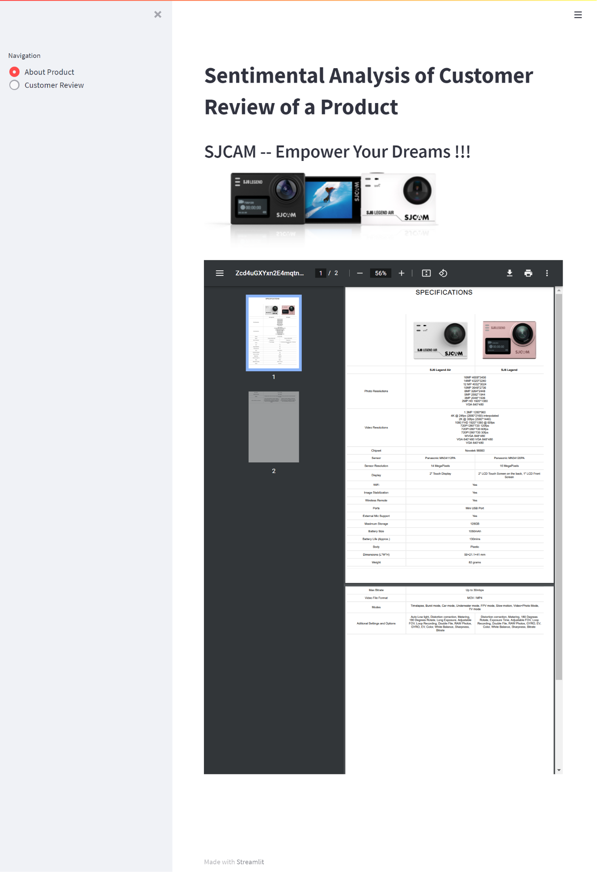
Deployment
Deployment is done through “Streamlit Package”
Deployed Link: https://share.streamlit.io/mariahsvaliaveedan/sentimental-analysis/main/app.py
The first page of deployment is “About Product” in which information regarding product is provided.

Slide 21
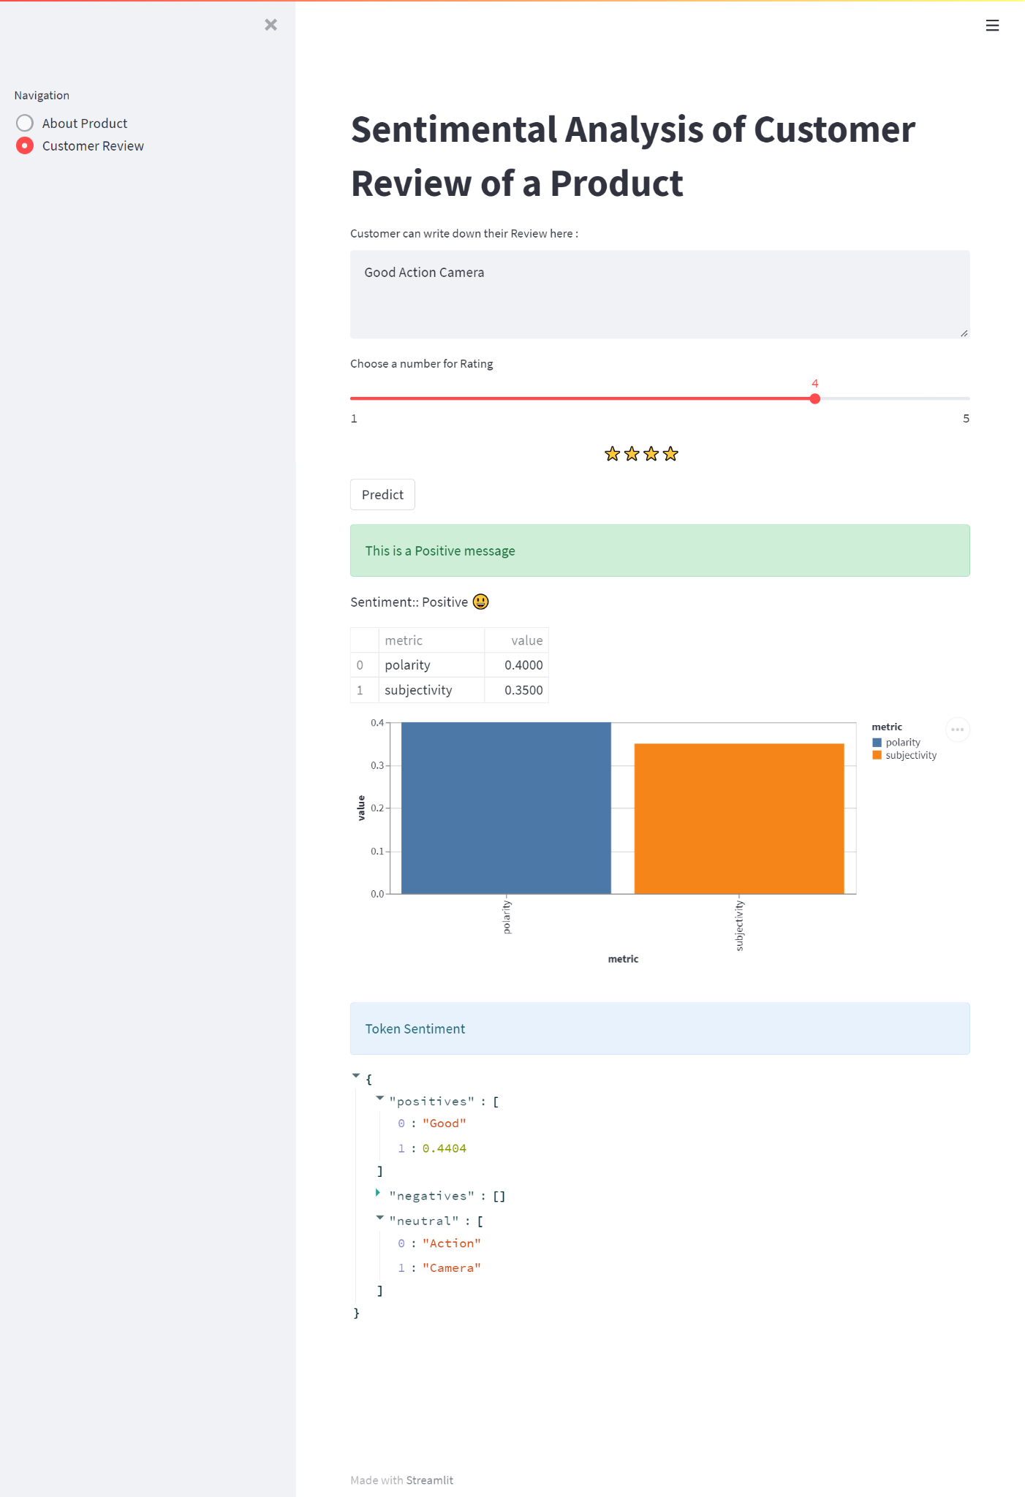
Deployment
The second page is of customer input and the result of sentimental analysis.
The following is about “Positive Sentiment” :

Slide 22
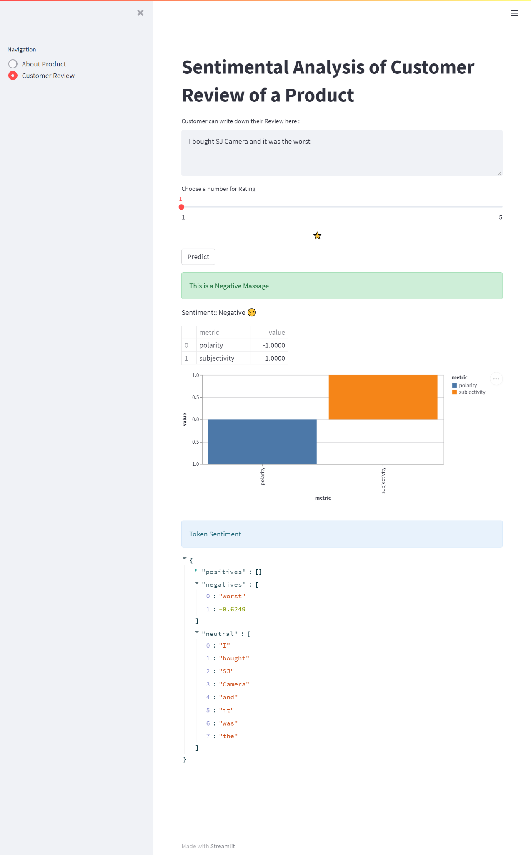
Deployment
The second page is of customer input and the result of sentimental analysis.
The following is about “Negative Sentiment” :

Slide 23
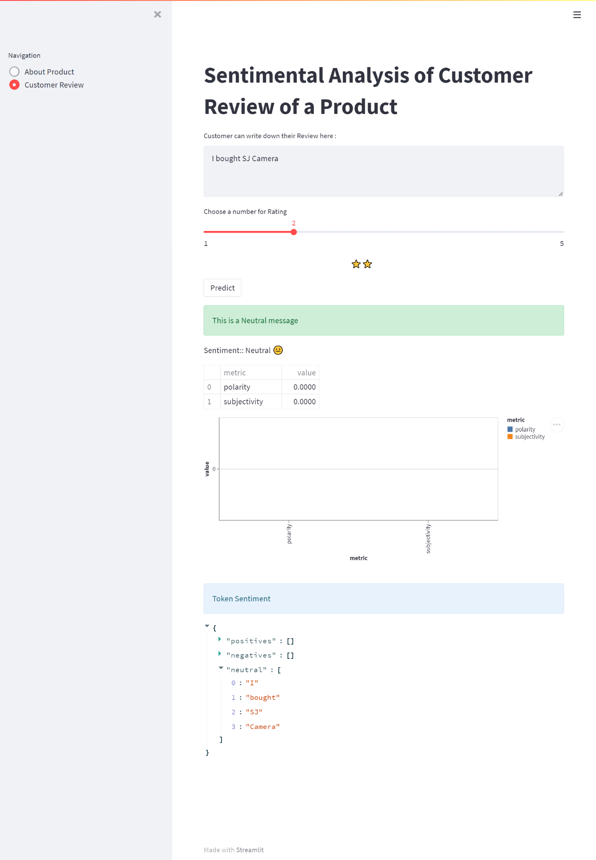
Deployment
The second page is of customer input and the result of sentimental analysis.
The following is about “Neutral Sentiment” :

Slide 24
Challenges Faced AND SOLUTIONS
Which method to choose for review extraction from Amzon.?
Beautiful Soup Library was used. as it was easy to code and understand
Which method to choose for sampling data, as the data was imbalanced.?
SMOTE-Tomek method was used as it combines oversampling and undersampling.
Which sentimental analysis method to use from various libraries available to classify the data.?
TextBlob was adopted as it was easy and accuracy was also good.

Slide 25
THANK YOU!

